Slide 1

PUBLIC HEALTH CAMPAIGN AWARENESS
Presented by,
m.dhivya,
s.nitisri,
c.rethanya,
s.thrishna.

Slide 2
MODULES
1)SPLITTING THE TRAINING AND TESTING DATA
2) APPLYING SUPPORT VECTOR MACHINES
3)CREATING DASHBOARD USING IBM COGNOS
4)CREATING REPORT USING IBM COGNOS
5)STATISTICAL TESTS USING TREEMAP

Slide 3
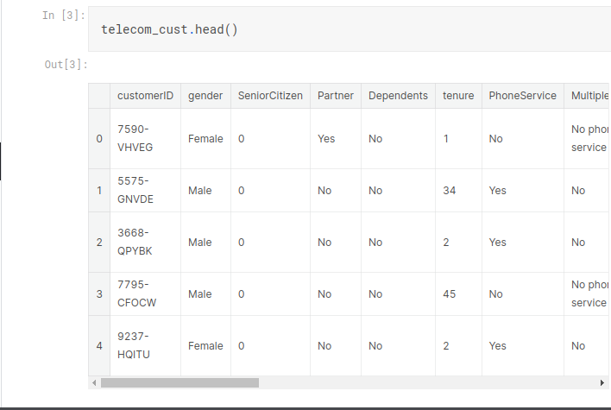
Step 1:SPLITTING THE TESTING AND TRAINING DATA

Slide 4
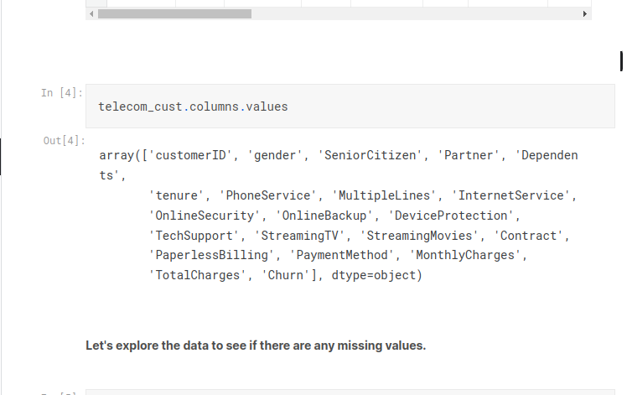
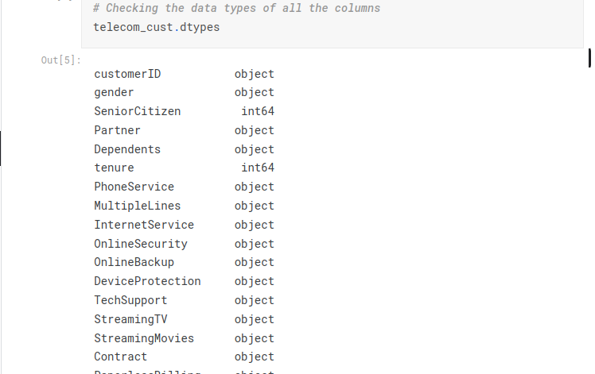

Slide 5
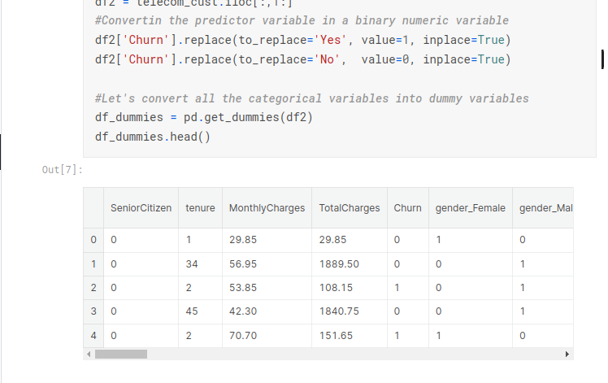
Step 2:Applying Support vector Machines and loss calculation

Slide 6
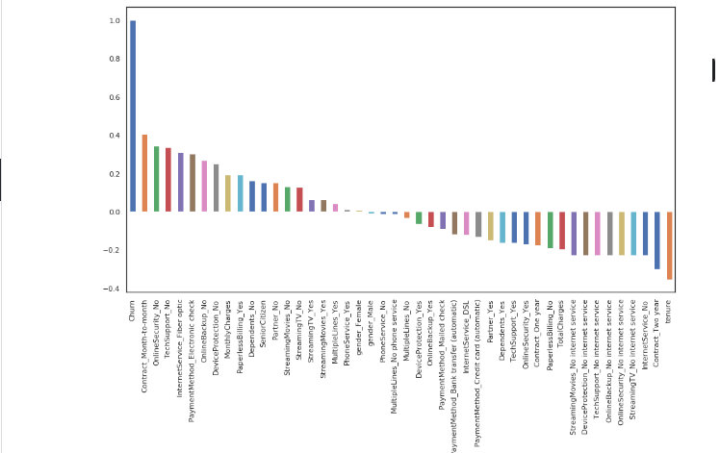

Slide 7
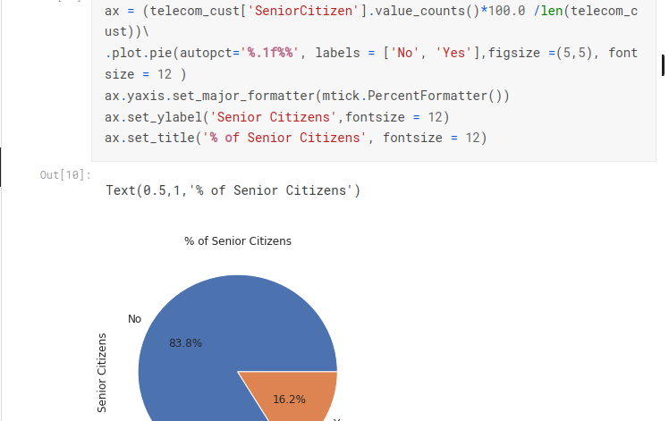

Slide 8
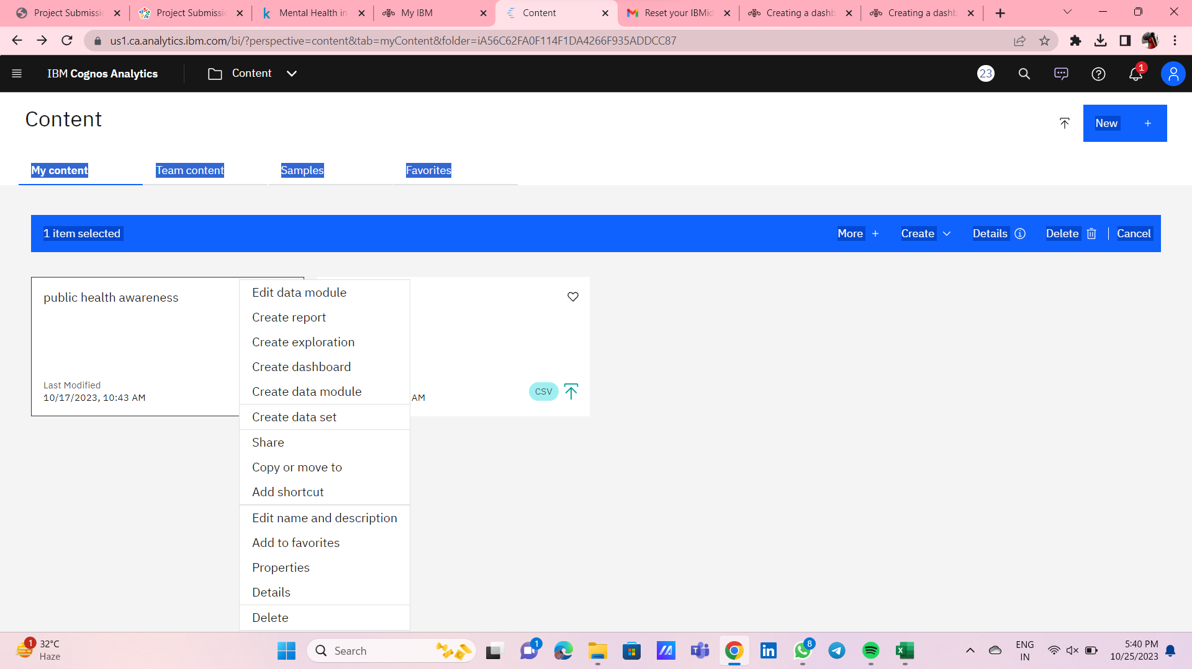
Step 3: CREATING DASHBOARD USING IBM COGNOS

Slide 9
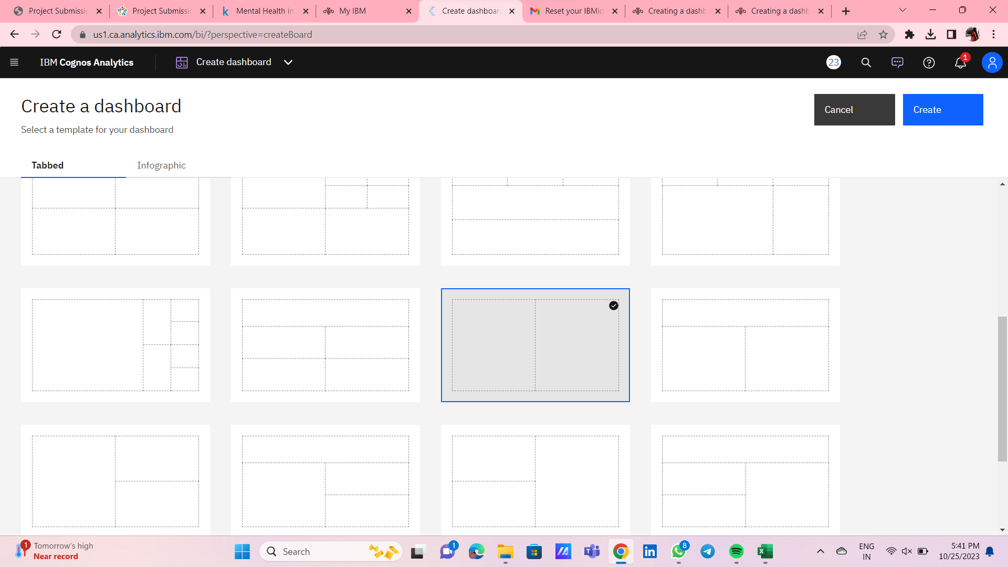

Slide 10
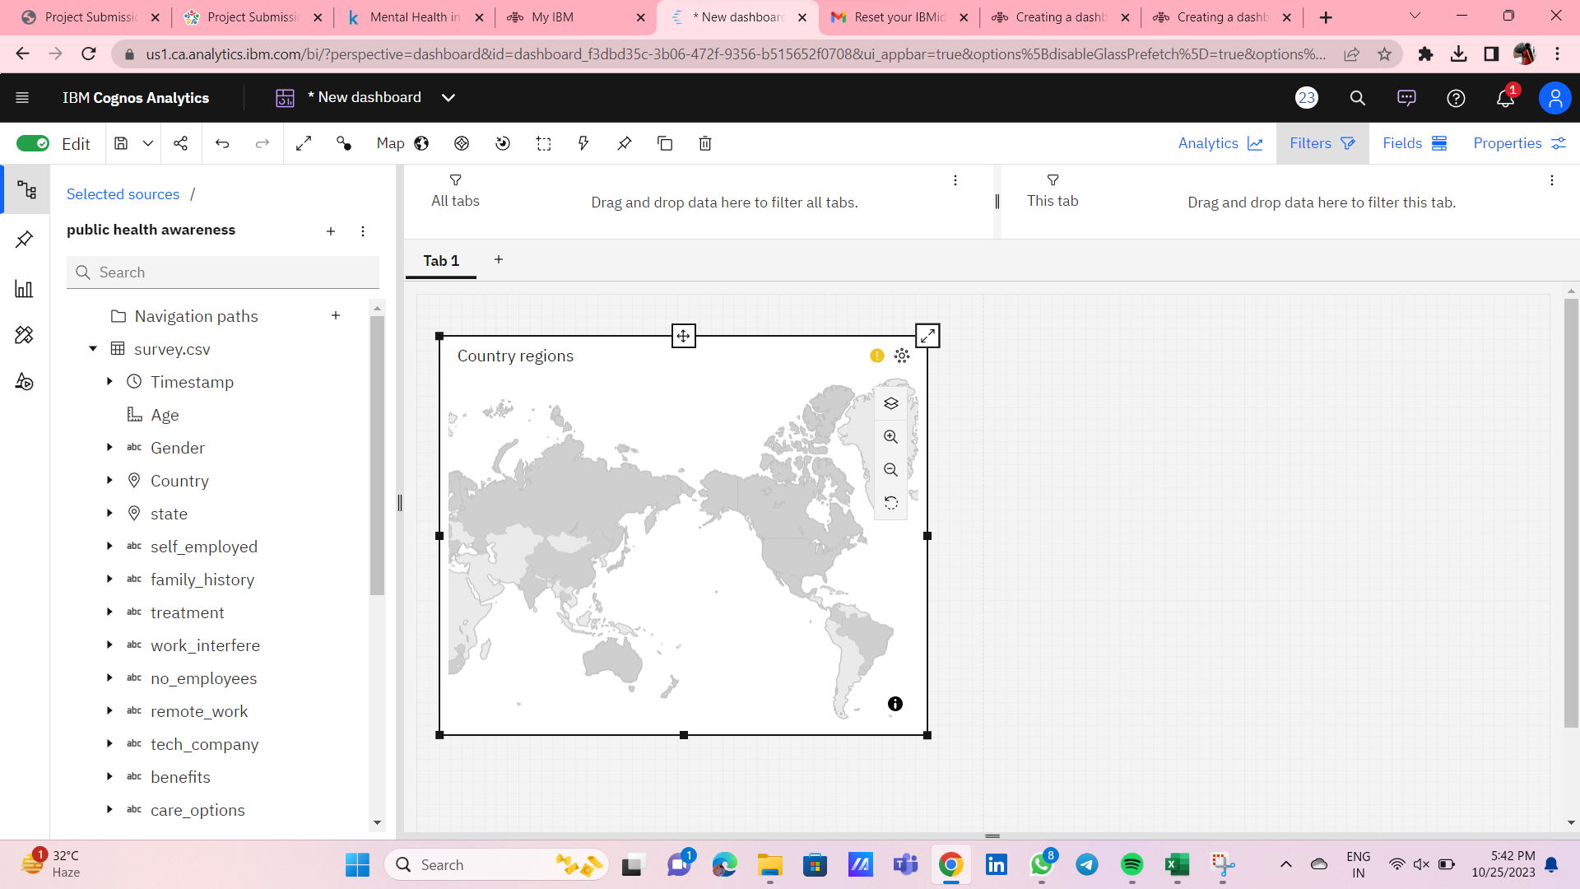

Slide 11
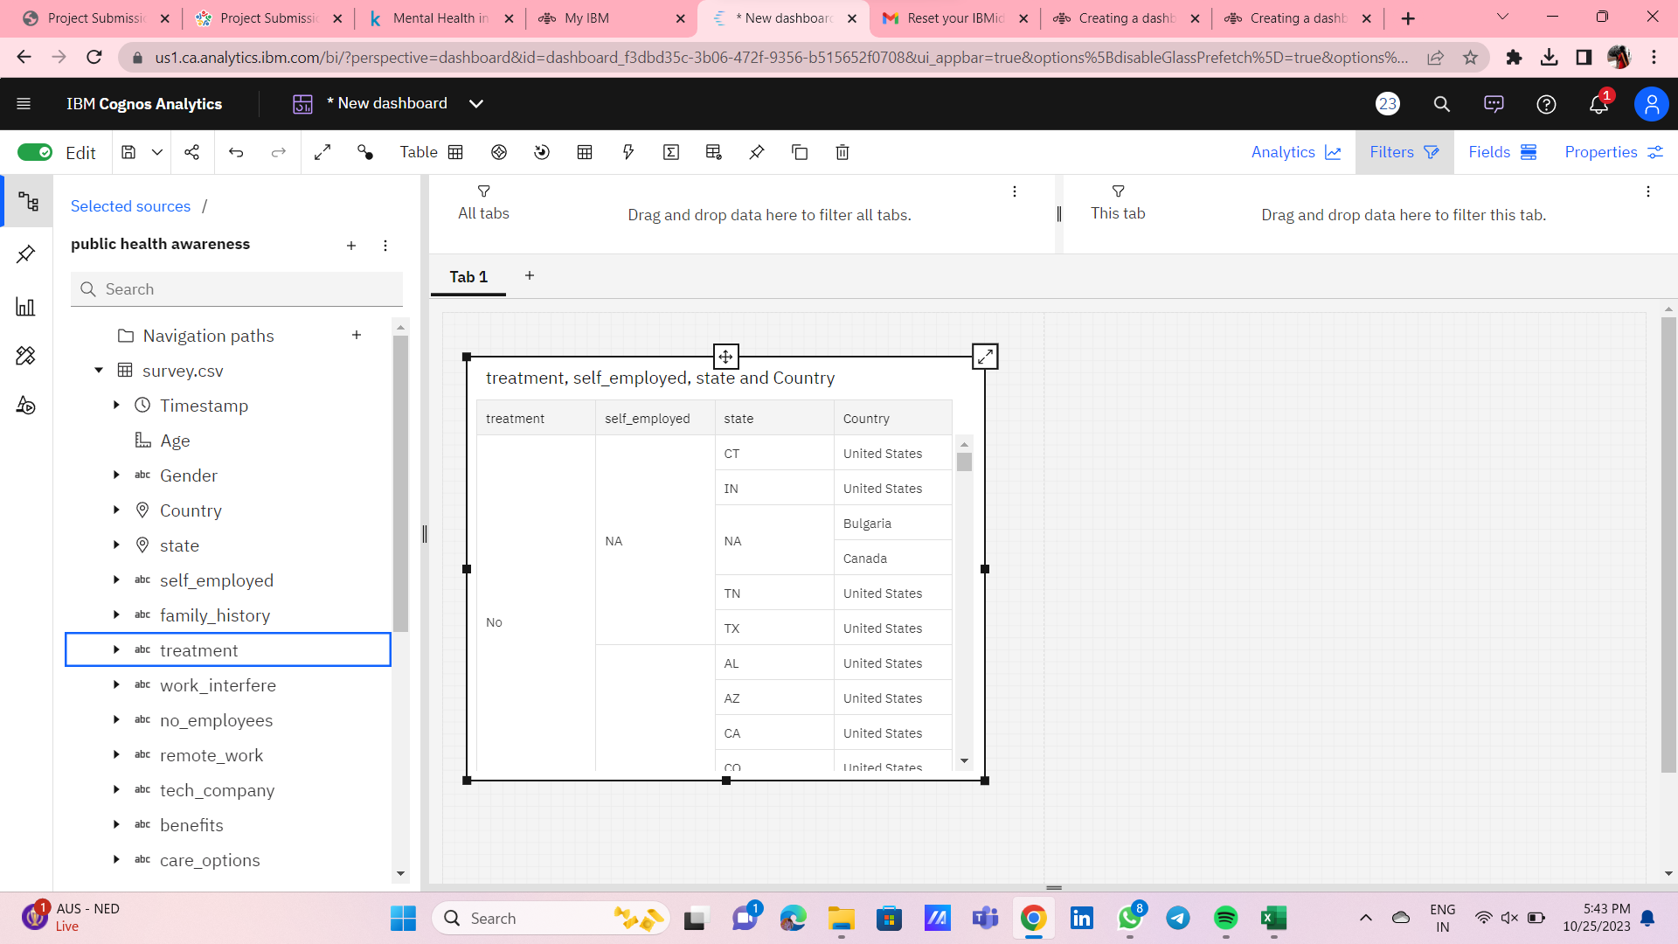

Slide 12
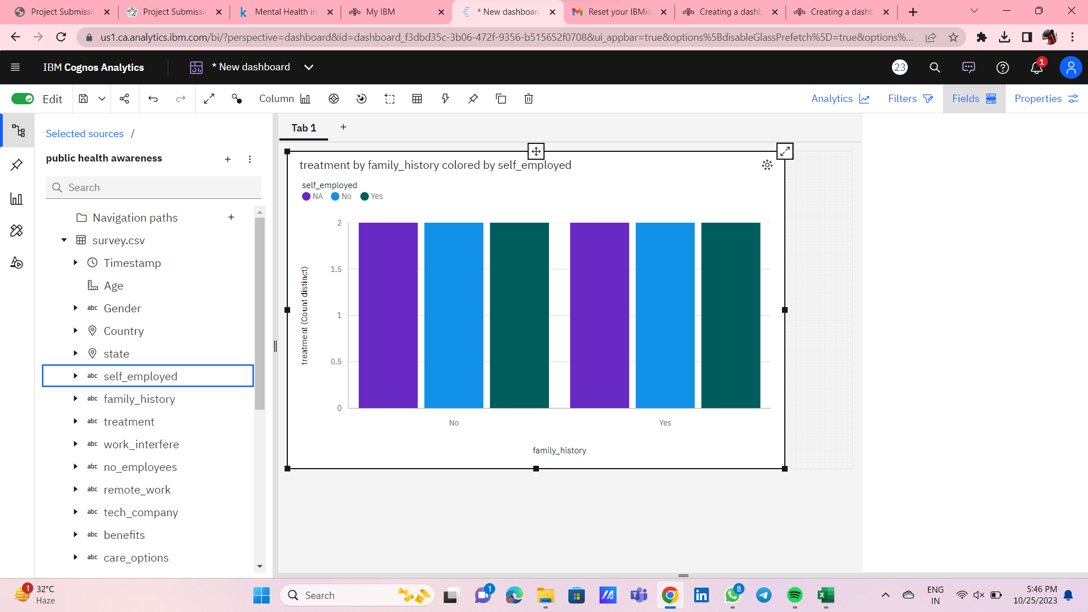
Creating bar graph using dashboard

Slide 13
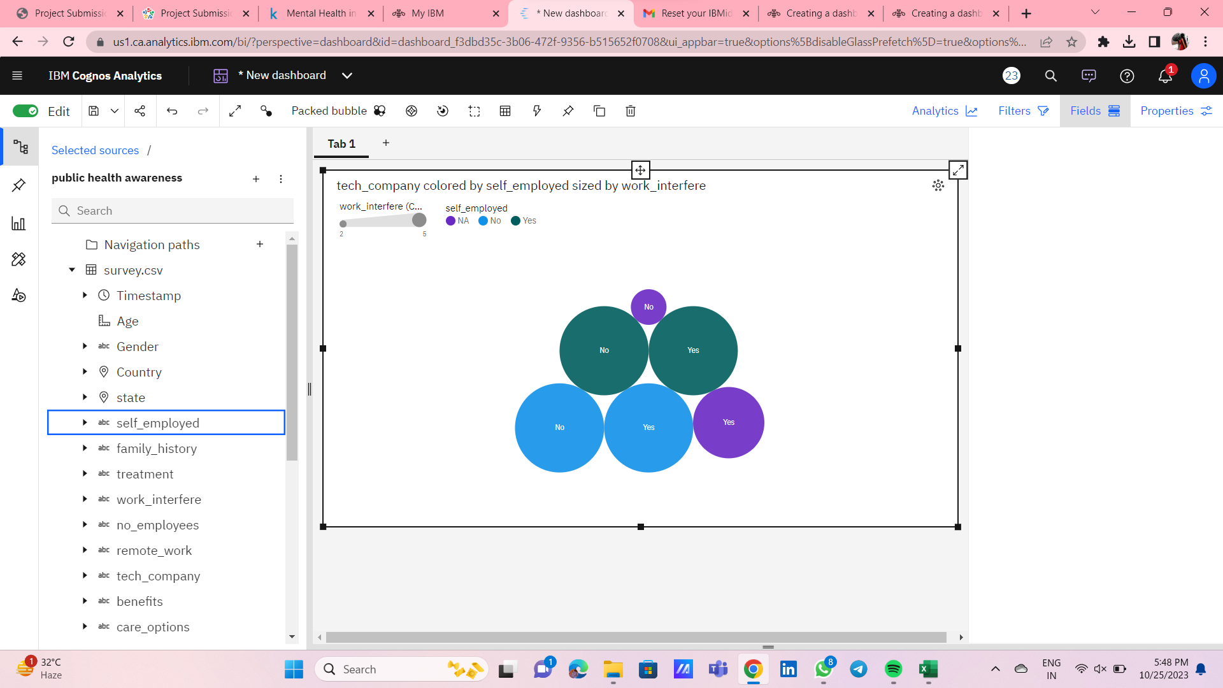
Creating packed ball structure using dashboard

Slide 14
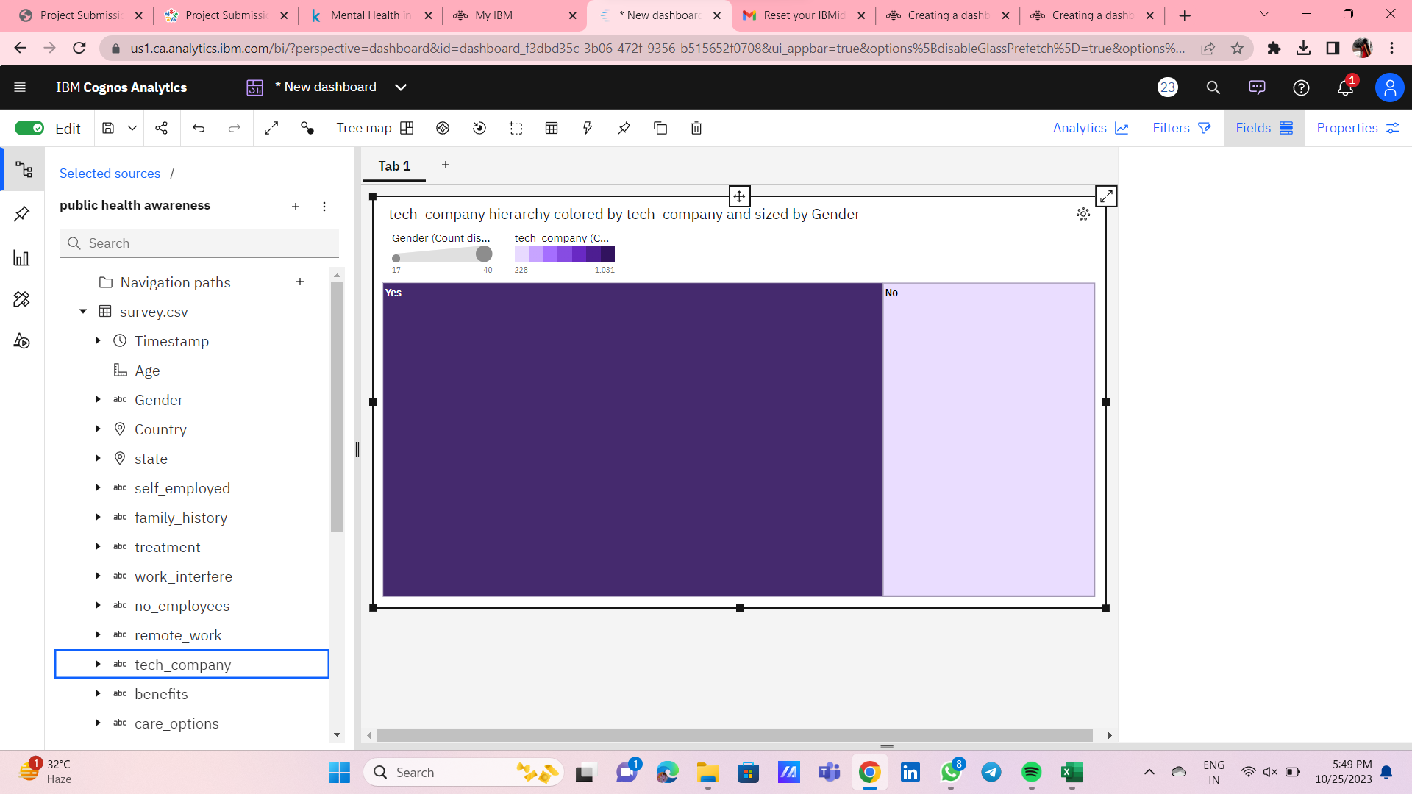
Creating area using dashboard

Slide 15
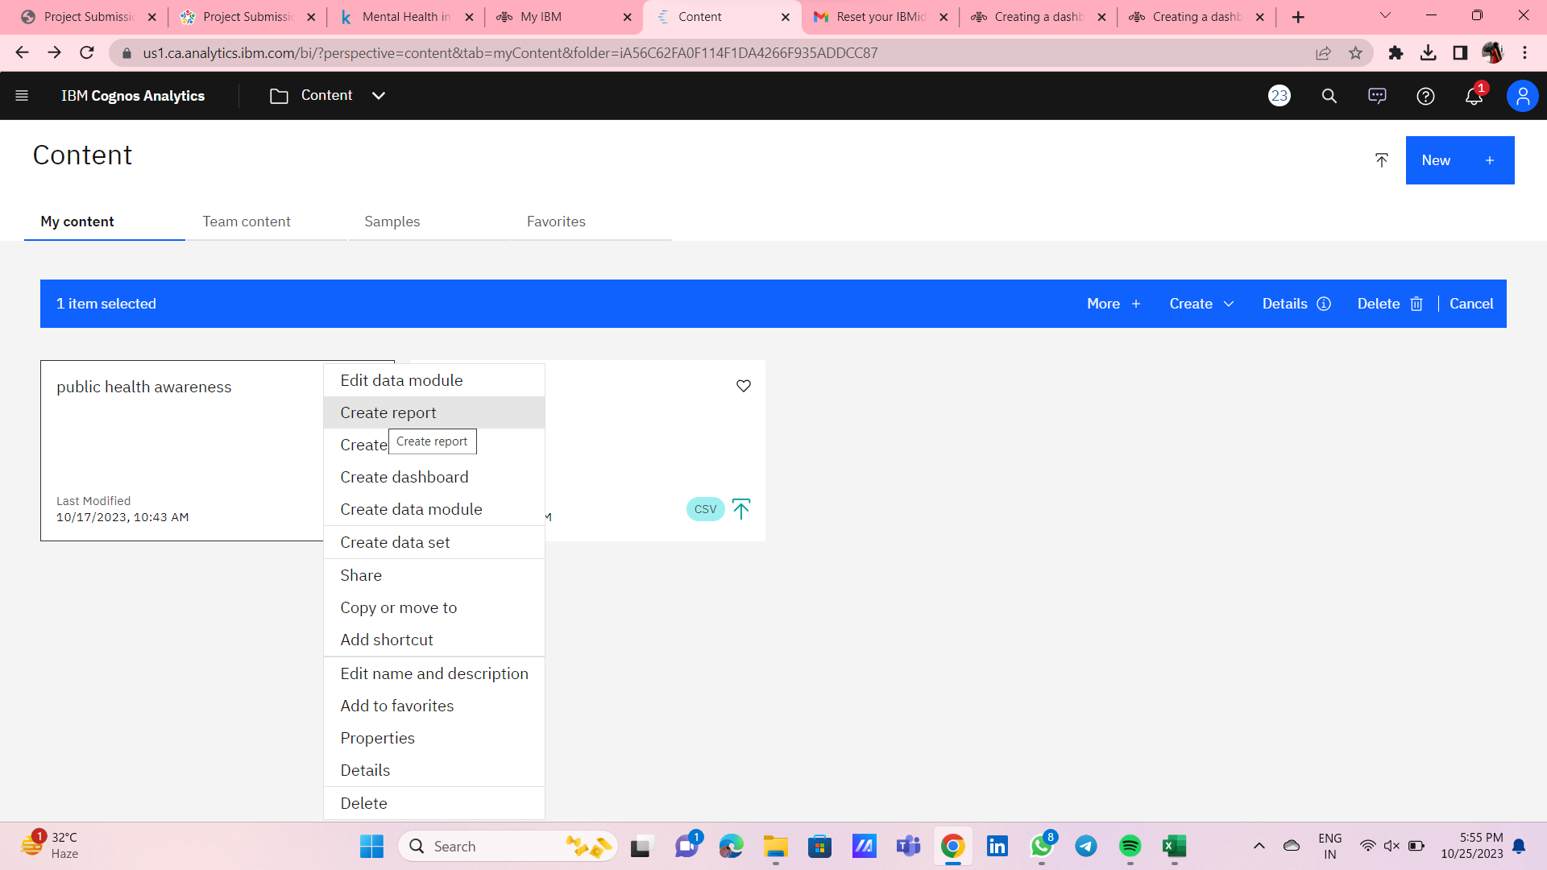
Step 4: CREATING REPORT USING IBM COGNOS

Slide 16
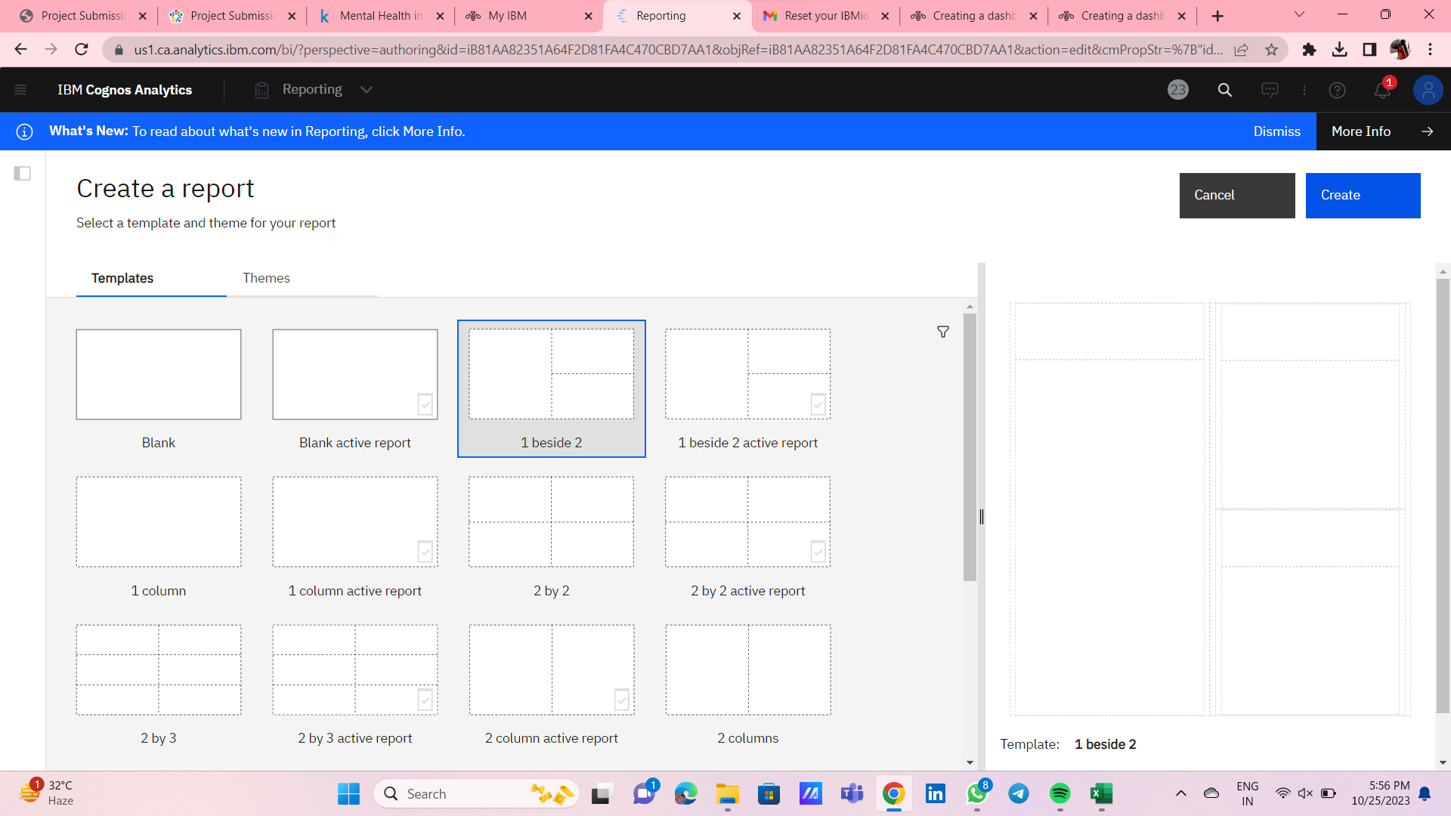

Slide 17
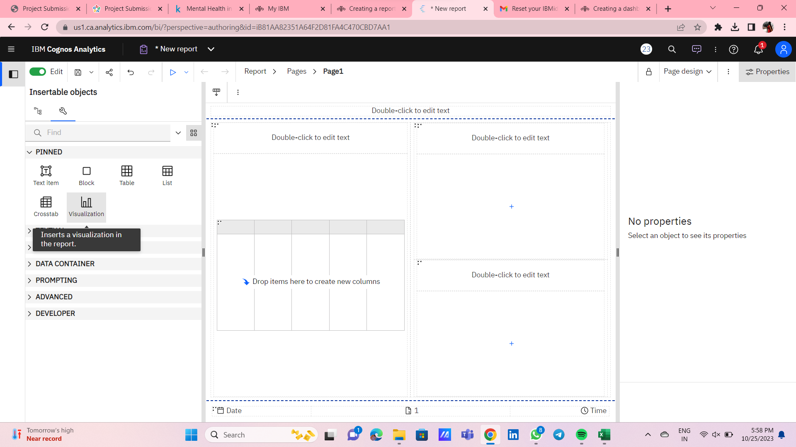

Slide 18
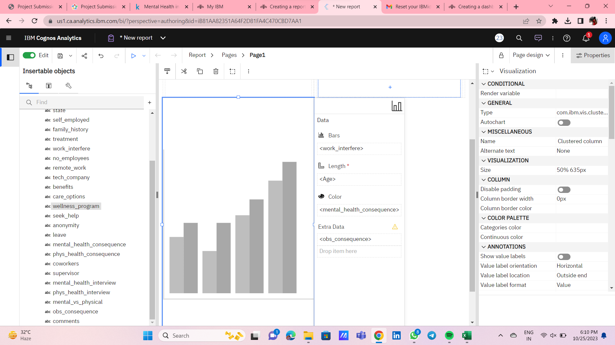
Creating bar graph using report

Slide 19
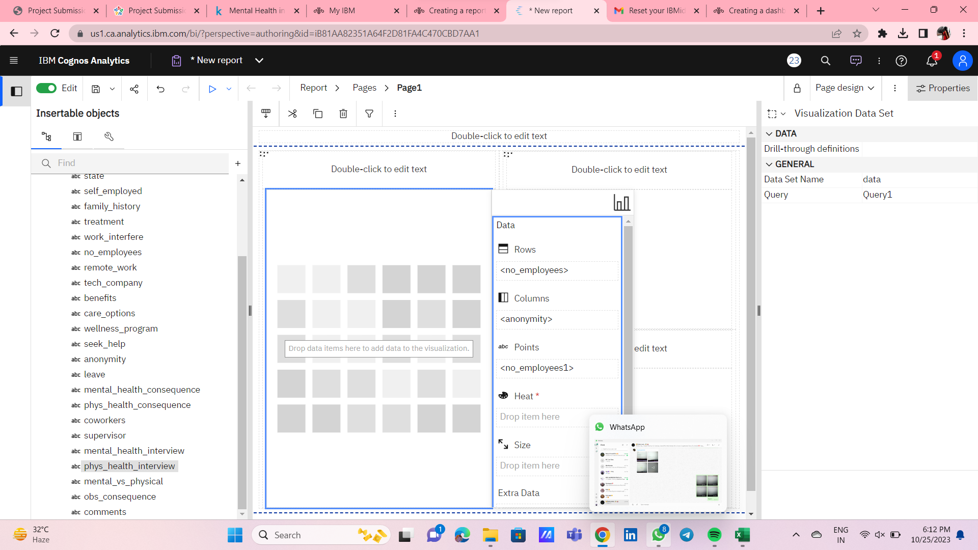

Slide 20
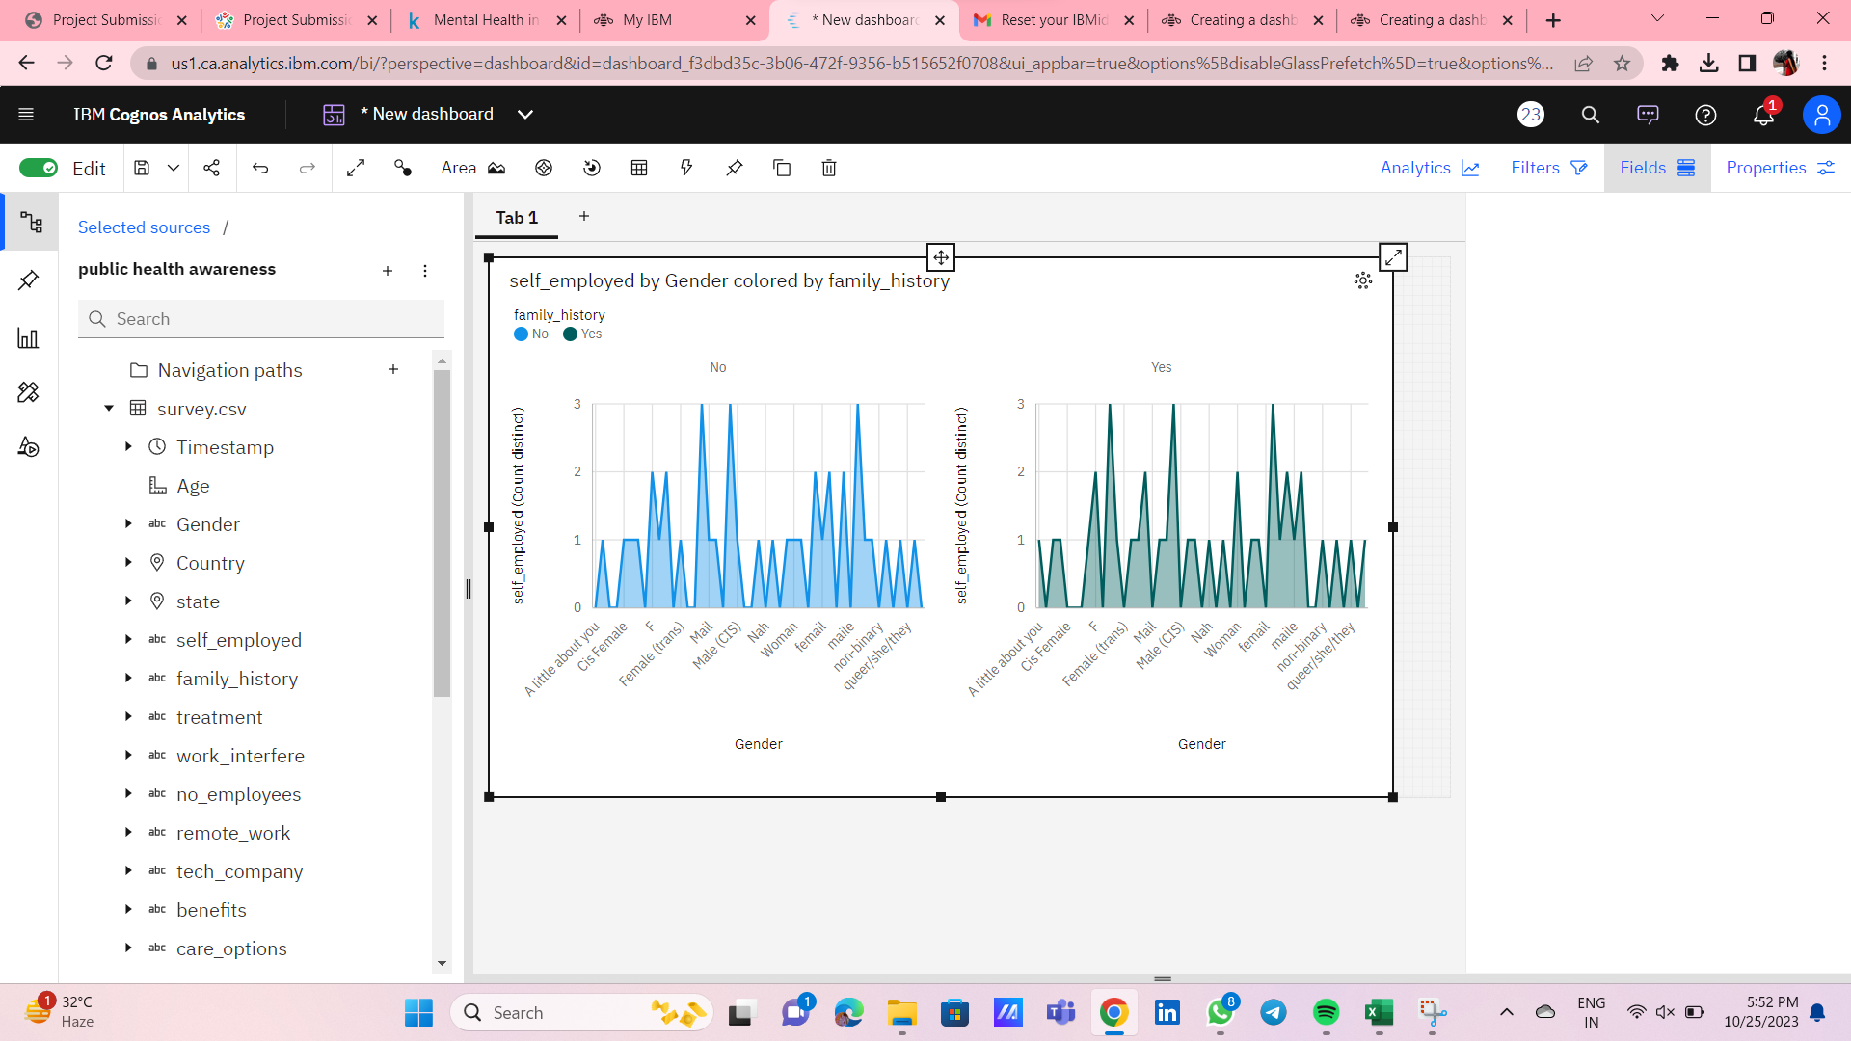
Step 5: STATISTICAL TESTS USING TREEMAP

